Slide 1
DTD
(Document Type Definition)

Slide 2
DTD
DTD stands for document type definition
Every XML document must be well formed however to be valid the xml document must comply with either DTD or schema.
DTD can either be internal or external

Slide 3
Document Type Declaration
<!DOCTYPE root_element_name [
Document Type Definition
]>

Slide 4
Example of internal DTD
<?xml version="1.0"?>
<!DOCTYPE student [
<!ELEMENT student (name,address,phone,email)>
<!ELEMENT name (#PCDATA)>
<!ELEMENT address (#PCDATA)>
<!ELEMENT phone (#PCDATA)>
<!ELEMENT email (#PCDATA)>
]>
<student>
<name>Ram Thapa</name>
<address>Kathmandu</address>
<phone>4240005</phone>
<email>ram@gmail.com</email>
</student>
Note: file will have .xml extension.

Slide 5
Declaring Elements
Elements in DTD are declared using <!ELEMENT> declaration
Syntax:
<!ELEMENT element_name content_model>

Slide 6
Plain text (PCDATA)
PCDATA stands for parsed character data
PCDATA is text that will be parsed by a parser. The text will be examined by the parser for entities and markup.
<book>
<title>XML</title>
</book>
If we need to declare <title> the we use the following syntax:
Syntax: <!ELEMENT element_name (#PCDATA)>
<!ELEMENT title (#PCDATA)>

Slide 7
ANY
ANY keyword indicates that text (PCDATA) and/or any elements declared within the DTD can be used in any order any number of times.
However, the ANY keyword does not allow you to include elements that are not declared within the DTD.
Syntax:
<!ELEMENT element_name ANY>

Slide 8
EMPTY
This element declaration does not contain any content. These are declared with the keyword EMPTY.
Syntax:
<!ELEMENT element_name EMPTY>
<?xml version = "1.0"?>
<!DOCTYPE hr[
<!ELEMENT address EMPTY>
]>
<address />

Slide 9
Multiple Child Elements (Sequence)
Child elements in a sequence is a comma separated list of elements which has to come in the same order while declaring it inside the parent element.
Syntax:
<!ELEMENT element_name (child_element_1, child_element_2, …)
<!ELEMENT student (name,address,phone)>

Slide 10
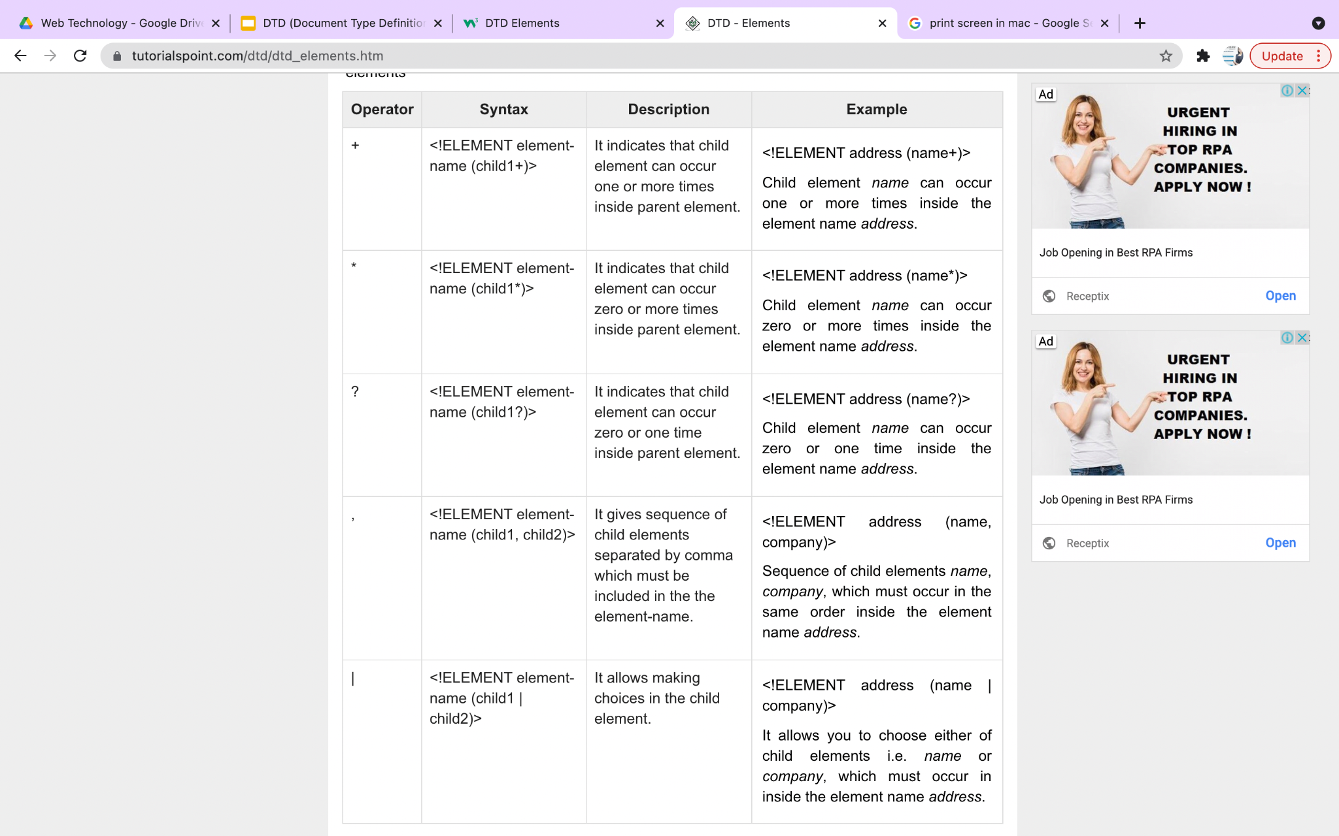
List of Operators and Syntax Rules

Slide 11
List of Operators and Syntax Rules

Slide 12
Declaring Only One Occurrence of an Element
<!ELEMENT element-name (child-name)>
Example:
<!ELEMENT note (message)>
<!ELEMENT message (#PCDATA)>
<note>
<message>hello</message>
</note>

Slide 13
Declaring Zero or More Occurrences of an Element
<!ELEMENT element_name (child_element_name *)>
<!ELEMENT student (phone *)>

Slide 14
Declaring Minimum One or more occurrence of an Element
<!ELEMENT element_name (child_element_name +)>
<!ELEMENT student (phone +)>

Slide 15
Declaring Zero or One Occurrences of an Element
<!ELEMENT element_name (child_element_name ?)>
<!ELEMENT student (phone ?)>

Slide 16
Choices
<!ELEMENT element_name (choice1 | choice2 | choice3)>
<!ELEMENT note (to,from,header,(message|body))>

Slide 17
Mixed Content
<!ELEMENT note (#PCDATA|to|from|header|message)*>
The example above declares that the "note" element can contain zero or more occurrences of parsed character data, "to", "from", "header", or "message" elements.

Slide 18
DTD Attributes
We need to define all the attributes present in our xml
Attributes are defined using the <!ATTLIST> declaration
We can define single attribute or all the attributes for a given element using single <!ATTLIST> declaration.
Syntax:
<!ATTLIST element_name
attribute_name attribute_type attribute_value
attribute_name attribute_type attribute_value>

Slide 19
DTD attribute
<!ATTLIST payment type CDATA "check">
XML example:
<payment type="cash" />

Slide 20
DTD attribute
The attribute-value can be one of the following:
Value | Explanation
value | The default value of the attribute
#REQUIRED | The attribute is required
#IMPLIED | The attribute is optional
#FIXED value | The attribute value is fixed

Slide 21
DTD attribute
Some of the problems with attributes are:
attributes cannot contain multiple values (child elements can)
attributes are not easily expandable (for future changes)
attributes cannot describe structures (child elements can)
attributes are more difficult to manipulate by program code
attribute values are not easy to test against a DTD
Note: If you use attributes as containers for data, you end up with documents that are difficult to read and maintain. Try to use elements to describe data. Use attributes only to provide information that is not relevant to the data.

Slide 22
A Default Attribute Value
DTD:
<!ELEMENT square EMPTY>
<!ATTLIST square width CDATA "0">
Valid XML:
<square width="100" />

Slide 23
#REQUIRED
Syntax:
<!ATTLIST element-name attribute-name attribute-type #REQUIRED>
DTD:
<!ATTLIST person number CDATA #REQUIRED>
Valid XML:
<person number="5677" />
Invalid XML:
<person />

Slide 24
#IMPLIED
Syntax:
<!ATTLIST element-name attribute-name attribute-type #IMPLIED>
DTD:
<!ATTLIST contact fax CDATA #IMPLIED>
Valid XML:
<contact fax="555-667788" />
Valid XML:
<contact />

Slide 25
#FIXED
Syntax:
<!ATTLIST element-name attribute-name attribute-type #FIXED "value">
DTD:
<!ATTLIST sender company CDATA #FIXED "Microsoft">
Valid XML:
<sender company="Microsoft" />
Invalid XML:
<sender company="Oracle" />

Slide 26
DTD Attribute Types
We have the following attribute types. The attribute_type field can be set to one of the following values.
Type | Description
CDATA | Character Data (text that doesn’t contain markup)
ENTITY | The name of the entity that must be declared in the DTD
ENTITIES | A list of entity names, separated by whitespaces. All the entities must be declared in the DTD
Enumerated | A list of values (Attribute must take any one value from the list)
ID | A unique identifier.
IDREF | Represent the value of an ID attribute of another element
IDREFS | Represent multiple ID values of other elements

Slide 27
DTD Attribute Types
Type | Description
NMTOKEN | A valid XML name
NMTOKENS | A list of valid XML names, separated by whitespace
NOTATION | A notation name (which must be declared in the dtd)

Slide 28
DTD - Entities
Entities are used to define shortcuts to special characters.
Entities can be declared internal or external.
Syntax: <!ENTITY entity-name "entity-value">
DTD Example:
<!ENTITY writer "Donald Duck.">
<!ENTITY copyright "Copyright W3C.">
XML example:
<author>&writer;&copyright;</author>

Slide 29
An External Entity Declaration
<!ENTITY entity-name SYSTEM "URI/URL">
DTD Example:
<!ENTITY writer SYSTEM "https://www.w3c.com/entities.dtd">
<!ENTITY copyright SYSTEM "https://www.w3c.com/entities.dtd">
XML example:
<author>&writer;&copyright;</author>

Slide 30
Parameter entities
<!ENTITY % ename "entity_value">
entity_value is any character except '&', '%' or ' " '
<!ENTITY % area "name, street, pincode, city">
<!ENTITY % contact "phone">
<!ELEMENT residence (%area;, %contact;)>
<!ELEMENT apartment (%area;, %contact;)>

Slide 31
Enumerated
Provides a list of possible values
Values must inside brackets and separated by Pipe “|”
Syntax:
<!ATTLIST element_name attribute_name (value_1 | value_2 | value_3 …..) default_value>
Example:
<!ATTLIST payment type (check|cash) "cash">
<payment type="check" />
or
<payment type="cash" />

Slide 32
ID
Used to identify elements uniquely
The value that is assigned to an attribute of type ID must be a valid XML name.
<!ATTLIST element_name attribute_name ID>
<!ATTLIST mountain mountain_id ID #REQUIRED>
<!ATTLIST student sid ID #REQUIRED>
<student sid=”S001”>...</student>

Slide 33
ID
VALID
<mountains>
<mountain mountain_id="m10001">
<name>Mount Cook</name>
</mountain>
<mountain mountain_id="m10002">
<name>Cradle Mountain</name>
</mountain>
</mountains>
INVALID
<mountains>
<mountain mountain_id="m10001">
<name>Mount Cook</name>
</mountain>
<mountain mountain_id="m10001">
<name>Cradle Mountain</name>
</mountain>
</mountains>

Slide 34
IDREF
The attribute type of IDREF is used for referring to an ID value of another element in the document.
Syntax:
<!ATTLIST element_name attribute_name IDREF default_value>
Example:
<!ATTLIST employee employee_id ID #REQUIRED
manager_id IDREF #IMPLIED>

Slide 35
IDREF
<employees>
<employee employee_id="e10001" manager_id="e10002">
<first_name>Homer</first_name>
<last_name>Flinstone</last_name>
</employee>
<employee employee_id="e10002">
<first_name>Fred</first_name>
<last_name>Burns</last_name>
</employee>
</employees>

Slide 36
IDREFS
The attribute type of IDREFS is used for referring to the ID values of more than one other element in the document. Each value is separated by a space.
Syntax:
<!ATTLIST element_name attribute_name IDREFS default_value>
Example
<!ATTLIST individual individual_id ID #REQUIRED parent_id IDREFS #IMPLIED>

Slide 37
IDREFS
<individuals>
<individual individual_id="e10001" parent_id="e10002 e10003">
<first_name>Bart</first_name>
<last_name>Simpson</last_name>
</individual>
<individual individual_id="e10002">
<first_name>Homer</first_name>
<last_name>Simpson</last_name>
</individual>
<individual individual_id="e10003">
<first_name>Marge</first_name>
<last_name>Simpson</last_name>
</individual>
</individuals>

Slide 38
NMTOKEN
An NMTOKEN (name token) is any mixture of Name characters. It cannot contain whitespace (although leading or trailing whitespace will be trimmed/ignored)
Syntax:
<!ATTLIST element_name attribute_name NMTOKEN default_value>
Example:
<!ATTLIST mountain country NMTOKEN #REQUIRED>

Slide 39
NMTOKEN
VALID
<mountains>
<mountain country="NZ">
<name>Mount Cook</name>
</mountain>
<mountain country="AUS">
<name>Cradle Mountain</name>
</mountain>
</mountains>
INVALID
<mountains>
<mountain country="New Zealand">
<name>Mount Cook</name>
</mountain>
<mountain country="Australia">
<name>Cradle Mountain</name>
</mountain>
</mountains>

Slide 40
NMTOKENS
The attribute type of NMTOKENS allows the attribute value to be made up of multiple NMTOKENSs, separated by a space.
Syntax:
<!ATTLIST element_name attribute_name NMTOKENS default_value>
Example:
<!ATTLIST mountain country NMTOKENS #REQUIRED>

Slide 41
NMTOKENS
Example:
<mountains country="NZ AU">
<mountain>
<name>Mount Cook</name>
</mountain>
<mountain>
<name>Cradle Mountain</name>
</mountain>
</mountains>

Slide 42
NOTATION
A notation is used to specify the format of non-XML data. A common use of notations is to describe MIME types such as image/gif, image/jpeg etc.
Syntax:
To declare a notation:
<!NOTATION GIF SYSTEM "image/gif">
<!NOTATION JPG SYSTEM "image/jpeg">
<!NOTATION PNG SYSTEM "image/png">
<!ATTLIST mountain photo ENTITY #IMPLIED
photo_type NOTATION (GIF | JPG | PNG) #IMPLIED>
<!ENTITY mt_cook_1 SYSTEM "mt_cook1.jpg">
Notes:
Multipurpose Internet Mail Extensions

Slide 43
NOTATION EXAMPLE
<mountains>
<mountain photo="mt_cook_1" photo_type="JPG">
<name>Mount Cook</name>
</mountain>
<mountain>
<name>Cradle Mountain</name>
</mountain>
</mountains>

